Slide 1
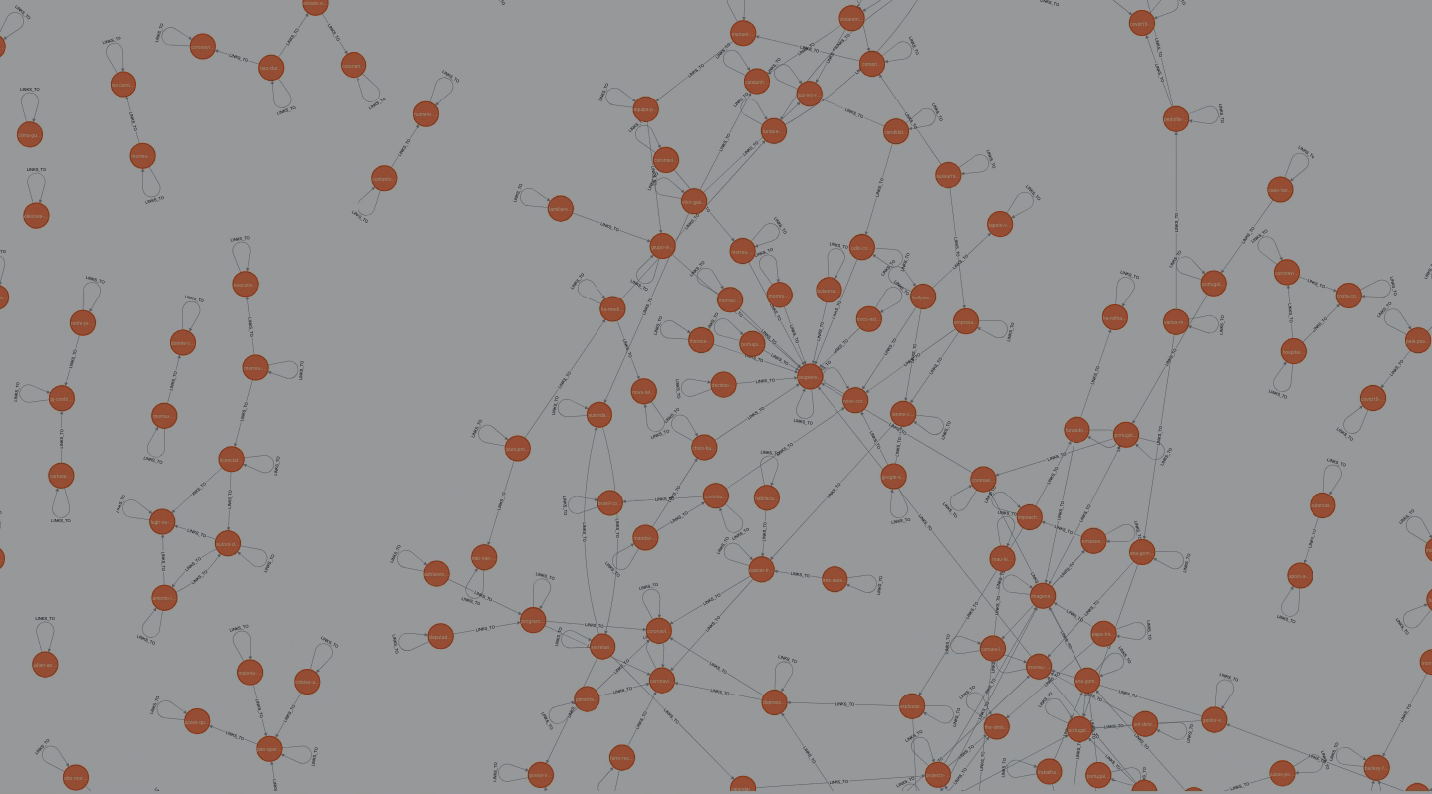
FCD- Web Graph Analysis
Final Presentation
Diogo Marto NºMec: 108298
diogo.marto@ua.pt

Slide 2
Index:
Previous improvements
Text extraction
Website
News Classifier
Future Work
Conclusion
‹#›

Slide 3
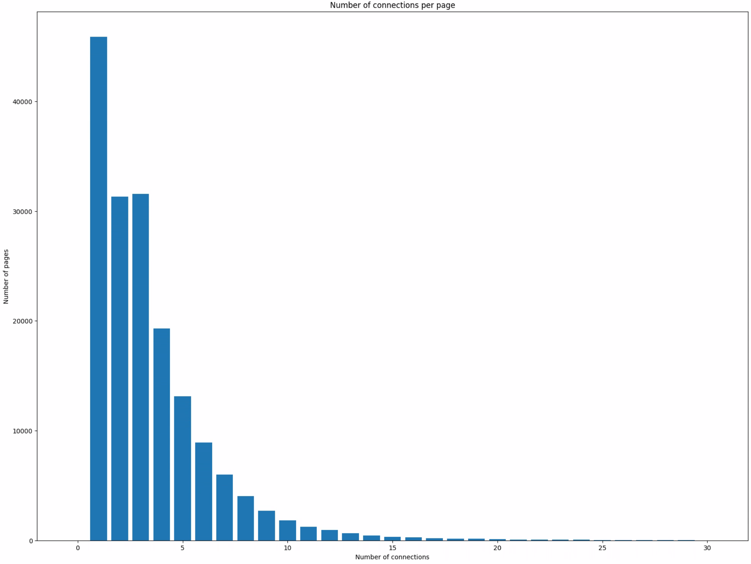
Previous improvements
- Moved files to another PC to prevent frying my laptop
Fix missing connections caused by inconsistent arquive links
    /noFrame/replay/ vs https://arquivo.pt/noFrame/replay/
Fix problem with parsing category and converting to lower
Speed up Neo4J insertion by 100x
Better error handling when querying arquivo
Sligthly change request to arquived page to reduce errors
‹#›

Slide 4
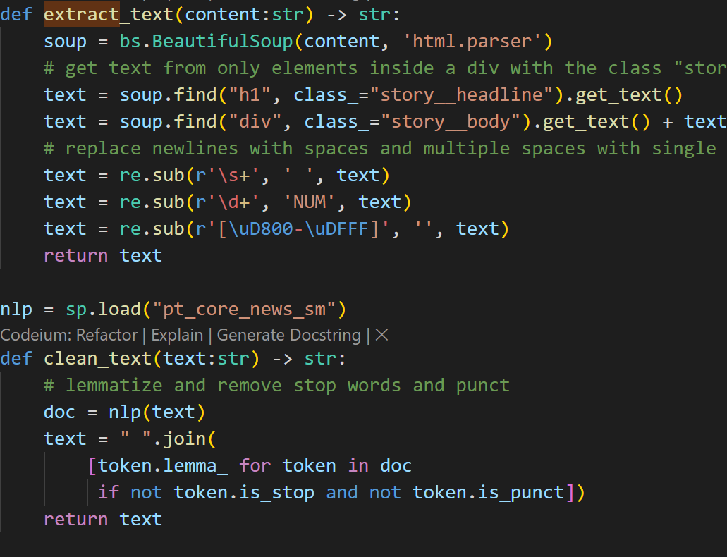
Text extraction
BeautifullSoup4 to extract news body and title
Using spacy and pt-sm-news-core
Remove stop words and punctuation
Lemmatization
Many news don’t have a lot of text since aruived pages have “Sign-in to read more”
3

Slide 5
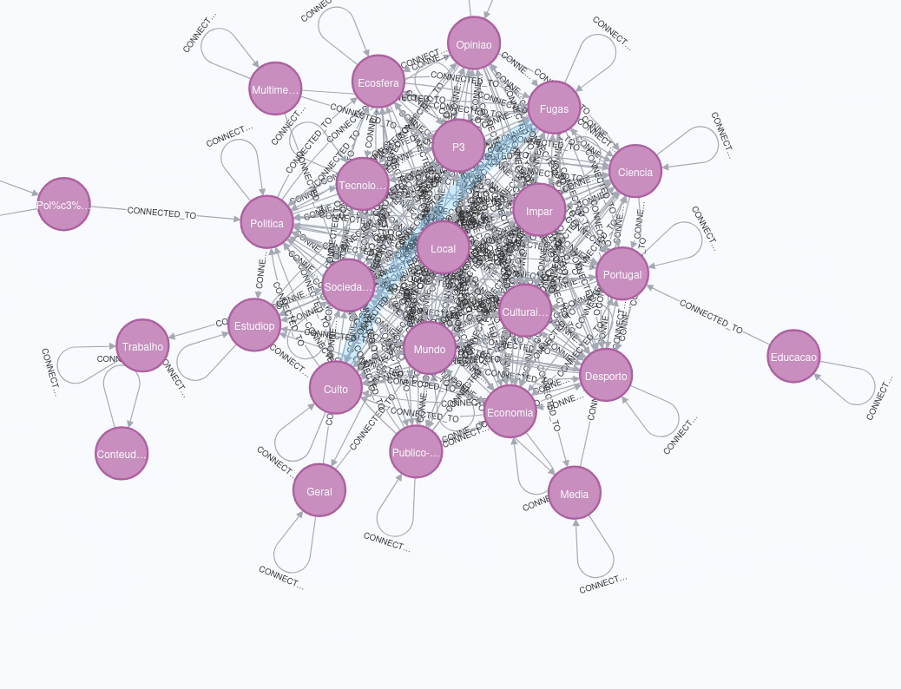
Website
Provide a way to visualize the graph and parts of the part in user firendly manner.
Visualize the information pertaining to each node including the web page.
Provide a way to extract graphs such as time series data and histograms
Provide a way to visualize aggregate graph by category.
4

Slide 6
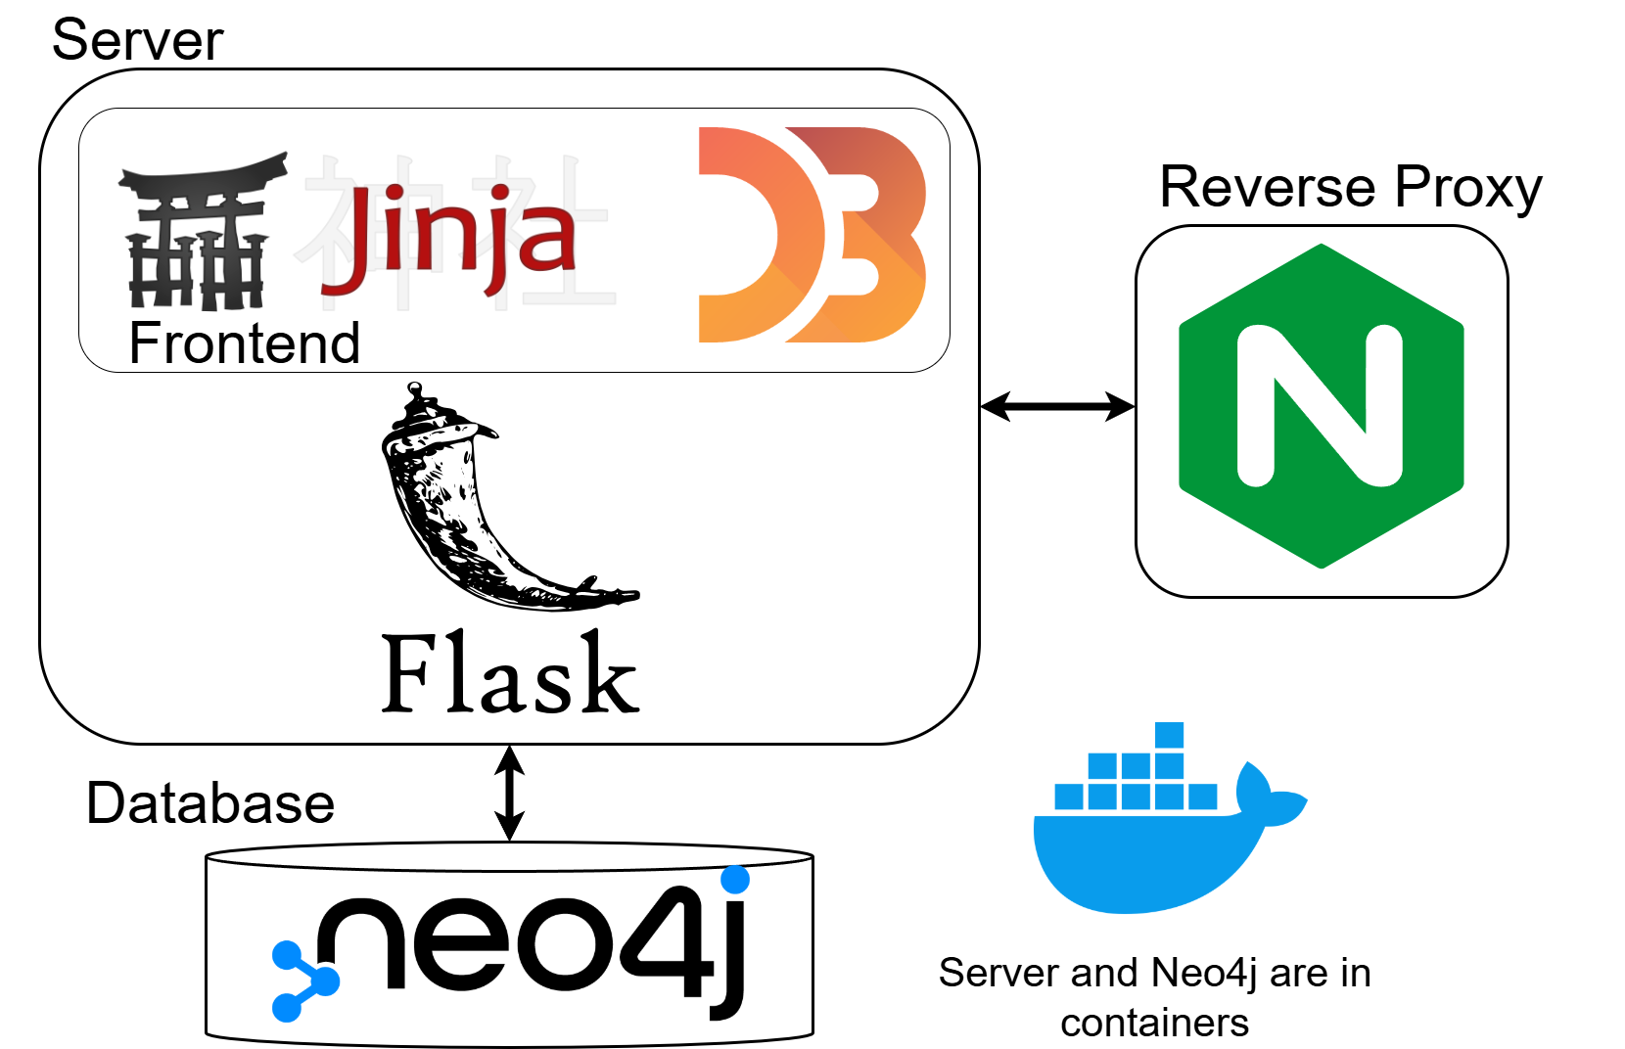
Website - Technology
‹#›

Slide 7
Website - Demo
‹#›

Slide 8
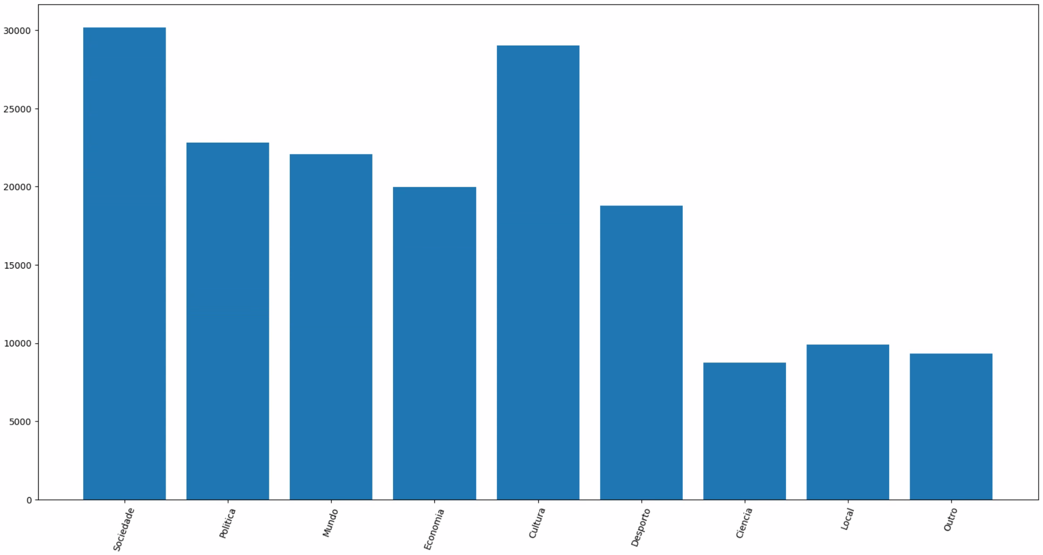
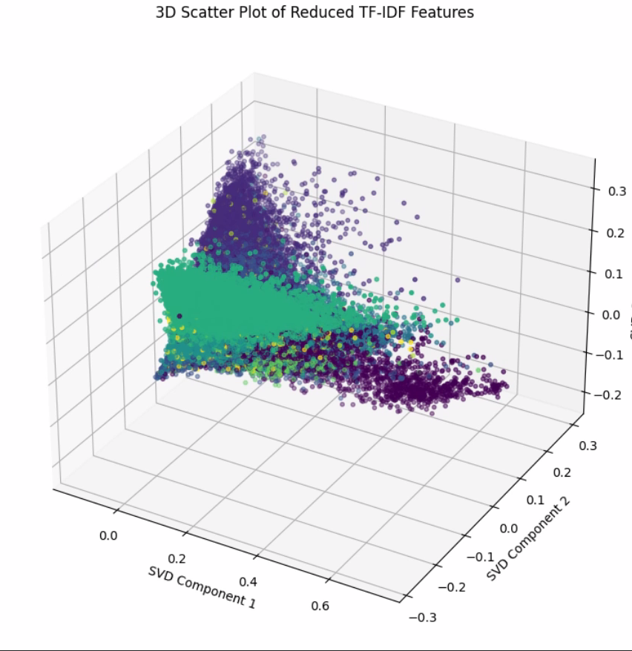
Model – Feature extraction
Use tf-idf on our dataset
Our labels are the categories from web scrapping but map to a reduced set
Class distribution is not uniform
PCA on tf-idf matrix shows that data is more or else clustered
Train-Test split of 0.15%.
‹#›

Slide 9
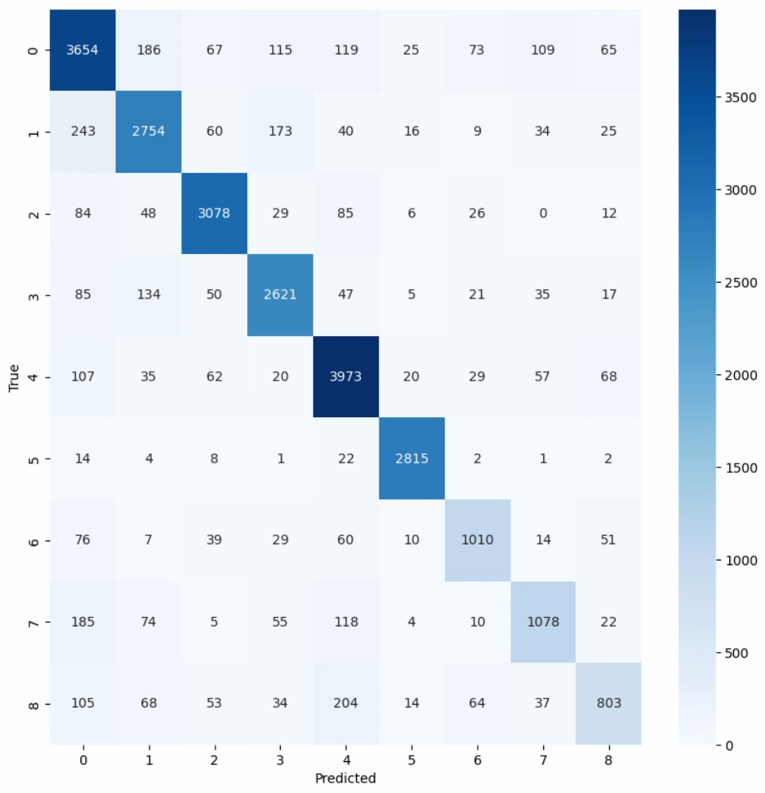
Model – Logistic Regression
Test Accuracy: 0.85 and train Accuracy: 0.91
Recall: 0.85 and Precision: 0.85 and F1-score:0.85
‹#›

Slide 10
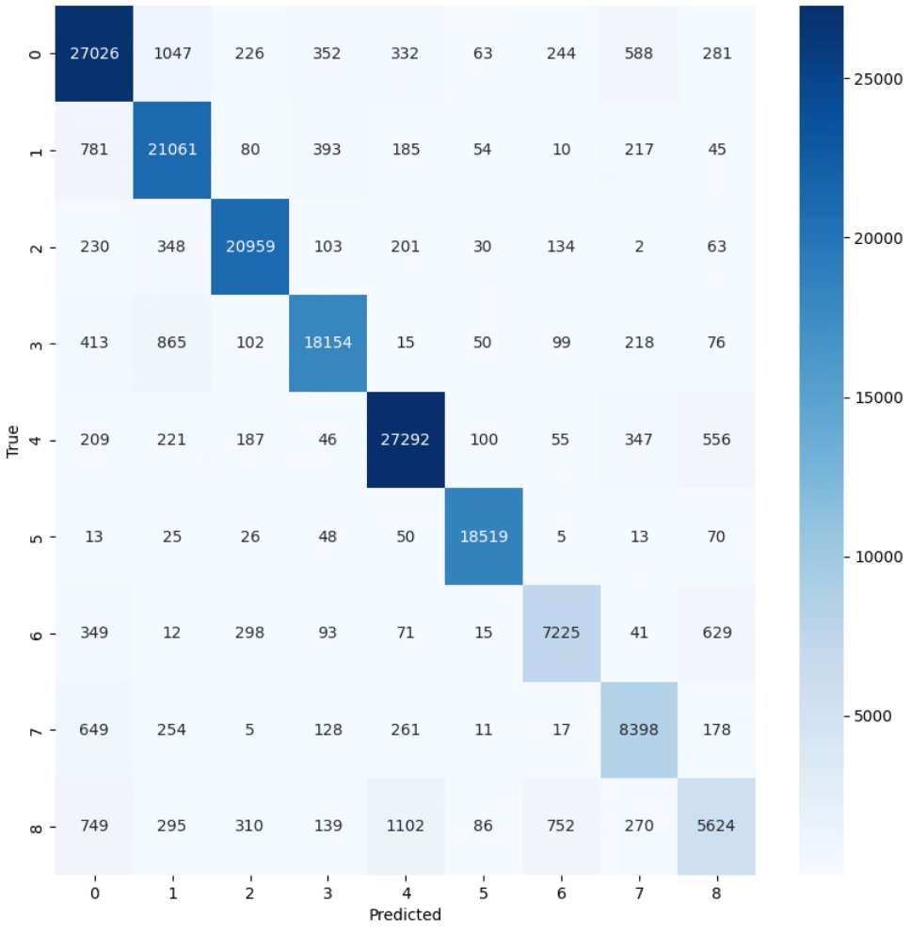
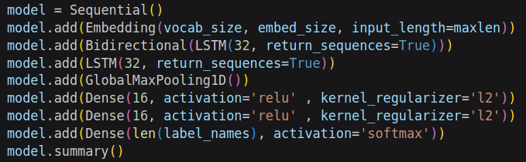
Model - LSTM
Input raw text data not tf-idf
Acc: 0.90 and Recall: 0.90 and Precision: 0.90 and F1-Score: 0.90
More expensive to run takes around 1 min to classify the whole dataset
‹#›

Slide 11
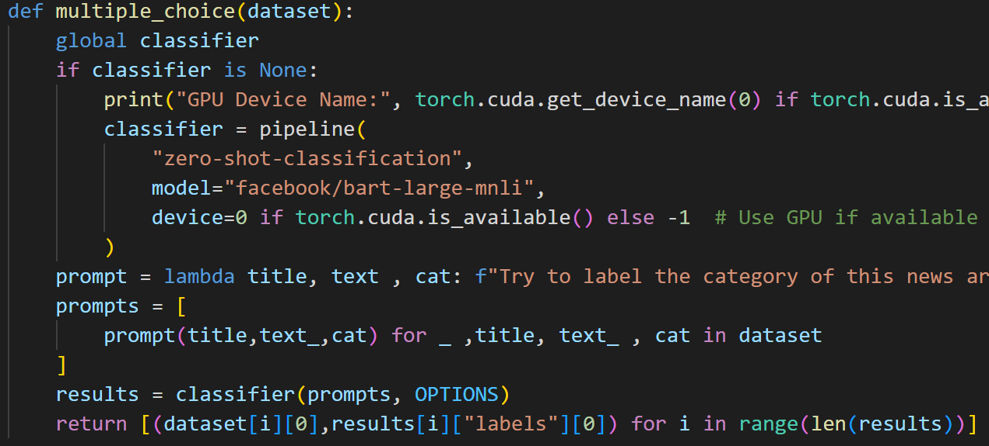
Failed idea
Use a large model to zero-shot classify the news based on a set of options
Classify only a small part of the dataset with zero-shot then use that has train data to build a simpler model and classify rest of documents
The model I used was giving poor results for zero-shot maybe because the news were in Portuguese
‹#›

Slide 12
Future improvements
Better UX for website
Employ a mechanics to build a classifier based on a set provided by user and then show on website
CI/CD pipeline
Use other sites besides publico.pt
‹#›

Slide 13
Conclusion
The main objectives of the work were accomplished and overall, I am happy with the result.
I would like to have more time to polish certain areas of the work and generate more visualizations.
I also learned a lot of things on this project and actually had fun making it.
‹#›

Slide 14
THANK YOU
‹#›

